Slide 1

Bangladesh Army International University Of Science And Technology
Title : ArNet A Deep Learning Architecture For Pixel-wise Semantic Segmentation Of Images
Presented By: Arik Md. Isthiaque
ID – 1103096
Section – B
Department of CSE, BAIUST
Supervised By: Arifa Islam Champa Lecturer Department of CSE, BAIUST

Slide 2
Introduction
Segmentation - Process that classify object in image
Figure 1: Visualization of how semantic segmentation works [1].

Slide 3
Challenges
Building the DCNN
Layer reduction
Time reduction
Add more classes
Calculate the class weights

Slide 4
Motivation for Research
SegNet: A Deep Convolutional Encoder-Decoder Architecture for Image Segmentation [2]
Build to understand road scenes
Model appearances and shapes
Understand the spatial resolution between classes
Used mostly for autonomous driving

Slide 5
Literature Review
In “Feedforward semantic segmentation with zoom-out features” Mohammadreza Mostajabi, Payman Yadollahpour, and Gregory Shakhnarovich represented the statistical structure of a image by a purely feed forward network by mapping Superpixels using zoom-out features [3]
In “Convolutional Feature Masking for Joint Object and Stuff Segmentation ” Jifeng Dai, Kaiming He, and Jian Sun image shape information was exploited by Convolutional Neural Network for object that are connected [4]

Slide 6
Methodology
Input RGB image
Encoder Layer
Decoder Layer
Classified feature maps
Figure 2: Overview of ArNet architecture.

Slide 7
Encoder Layer
2D Convolution
Batch Normalization
ReLU
2D MaxPooling
2D Convolution
Batch Normalization
ReLU
2D MaxPooling
2D Convolution
Batch Normalization
ReLU
2D MaxPooling
2D Convolution
Batch Normalization
ReLU
Figure 3: The Encoder layer.

Slide 8
Encoder Layer
2D Convolution
Batch Normalization
ReLU
2D MaxPooling
Normalize by re-centering and re-scaling
Improve the performance and randomness
2D Convolution
Batch Normalization
ReLU
2D MaxPooling
2D Convolution
Batch Normalization
ReLU
2D MaxPooling
2D Convolution
Batch Normalization
ReLU
Figure 4: The Encoder layer.

Slide 9
Encoder Layer
2D Convolution
Batch Normalization
ReLU
2D MaxPooling
Rectified Linear Unit activation function
Returns 1 if the output is passed to the next block
2D Convolution
Batch Normalization
ReLU
2D MaxPooling
2D Convolution
Batch Normalization
ReLU
2D MaxPooling
2D Convolution
Batch Normalization
ReLU
Figure 5: The Encoder layer.

Slide 10
2D Convolution
Figure 6: A 2D convolution operation [5].

Slide 11
2D MaxPooling
Figure 7: 2D MaxPooling [6].

Slide 12
Decoder Layer
2D Deconvolution
Batch Normalization
2D UnPooling
2D Deconvolution
Batch Normalization
2D UnPooling
2D Deconvolution
Batch Normalization
2D UnPooling
2D Deconvolution
Batch Normalization
SoftMax
Figure 8: The Decoder layer.

Slide 13
Decoder Layer
2D Deconvolution
Batch Normalization
2D UnPooling
Exactly the opposite of 2D Convolution operation
2D Deconvolution
Batch Normalization
2D UnPooling
2D Deconvolution
Batch Normalization
2D UnPooling
2D Deconvolution
Batch Normalization
SoftMax
Figure 9: The Decoder layer.

Slide 14
Decoder Layer
2D Deconvolution
Batch Normalization
2D UnPooling
Exactly the opposite of 2D MaxPooling
Remaining elements being set to zero
2D Deconvolution
Batch Normalization
2D UnPooling
2D Deconvolution
Batch Normalization
2D UnPooling
2D Deconvolution
Batch Normalization
SoftMax
Figure 10: The Decoder layer.

Slide 15
Decoder Layer
2D Deconvolution
Batch Normalization
2D UnPooling
2D Deconvolution
Batch Normalization
2D UnPooling
2D Deconvolution
Batch Normalization
2D UnPooling
2D Deconvolution
Batch Normalization
SoftMax
Scale the output in the form of 0 to 1
Figure 11: The Decoder layer.

Slide 16
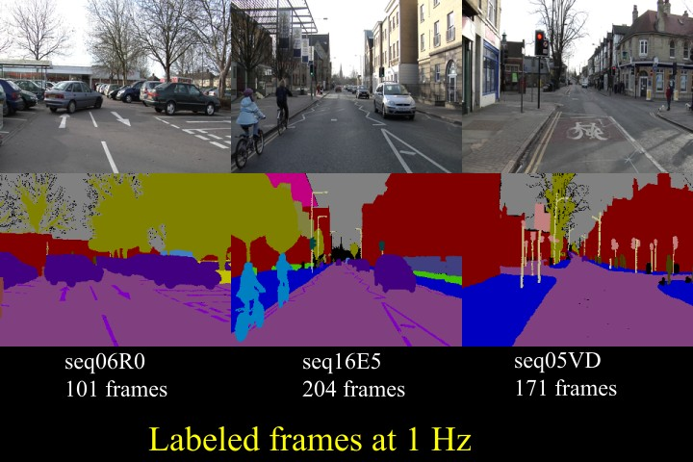
Dataset
Figure 12: Some random image from the CamVid Dataset [2].

Slide 17
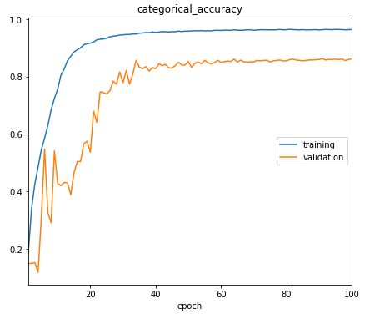
Result
Figure 13: Categorical accuracy per epoch of the training and validation data.

Slide 18
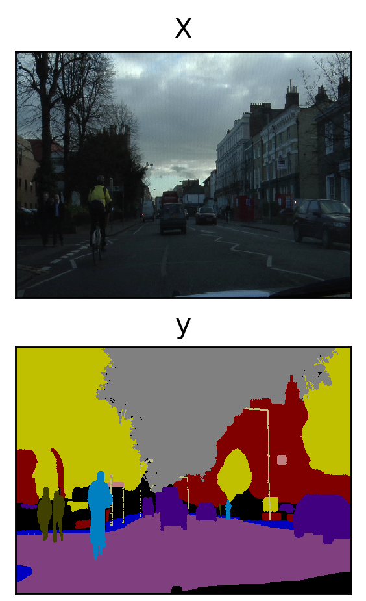
Result
(a) Input Image
(b) Visualization of feature map
Figure 14: Visualizing the results of ArNet architecture.

Slide 19
Comparison
Table 1: Validation accuracy comparison between some the state-of-the-art architecture and ArNet.
Architecture | Validation Accuracy | Time Per Epoch (avg)
FCN8 [13] | 62.5% | 12 minutes
SegNet [18] | 88.0% | 1.6 hours
FC-DenseNet100 [19] | 91.2% | 13 hours ( only one epoch was done completely)
ArNet | 88.7% | 32 minutes

Slide 20
Limitations
Machine oriented architecture
Very time consuming
32 minutes per epoch on average
Low number of dataset

Slide 21
Conclusion
Improve machine visions
Improve robotics
Improve autonomous driving technology

Slide 22
Future Work
Lower number of blocks
Lower processing time
More dataset
Interface canny edge detector

Slide 23
References
A. A. Novikov, D. Lenis, D. Major, J. Hladůvka, M. Wimmer, K. Bühler, “Fully Convolutional Architectures for Multi-Class Segmentation in Chest Radiographs”, Computer Vision and Pattern Recognition, (Submitted on 30 Jan 2017 (v1), last revised 13 Feb 2018 (this version, v4)).
V. Badrinarayanan, A. Kendall, R. Cipolla, Senior Member, IEEE, “SegNet: A Deep Convolutional Encoder-Decoder Architecture for Image Segmentation “ [2017 TPAMI] h ttps://arxiv.org/abs/1511.00561.
M. Mostajabi, P. Yadollahpour, G. Shakhnarovich, “Feedforward semantic segmentation with zoom-out features “, Computer Vision and Pattern Recognition, (Submitted on 2 Dec 2014). arXiv:1412.0774.
J. Dai, K. He, J. Sun, “Convolutional Feature Masking for Joint Object and Stuff Segmentation” The IEEE Conference on Computer Vision and Pattern Recognition (CVPR), 2015, pp. 3992-4000

Slide 24
References
D. Torres, Alejandro (Nov 2, 2010). "Origin and history of convolution". 41 pgs. http://www.slideshare.net/Alexdfar/origin-adn-history-of-convolution. Cranfield, Bedford MK43 OAL, UK. Retrieved March 13, 2013.
Q. Zhao, S. Lyu, B. Zhang, and W. Feng, “Multiactivation Pooling Method in Convolutional Neural Networks for Image Recognition”, Big IoT Data Analytics in Fog Computing, Volume- 2018, Article ID-8196906, https://doi.org/10.1155/2018/8196906.

Slide 25
Thank you…..

